Slide 1

Denominators Team
Home > HQ > Interagency Collaborative for Program Involvement (ICPI) > General> Clusters >
https://github.com/ICPI/Denominators
Team Lead: Roma Bhatkoti, Joshua Davis
ICPI Lead: Jasmine Buttolph
Members: JP Abellera, Travis Lim, Ray Shiraishi, Mohammed Mujawar, James Houston, Ian Fellows, Randy Yee, Anubhuti Mishra, Aaron Chafetz, Noah Bartlett, Kim Marsh, Ian Wanyeki, Jeff Eaton, Oliver Stevens, Athena Pantazis, Yaa Obeng-Aduasare, Jasmine Buttolph, Shaylee Mehta, Scott Jackson, Parviez Hosseini
Week of July 22nd , 2019
First team presentation to ICPI Will provide regular updates (to be scheduled) during the inbrief Inbrief Presentation

Slide 2
Denominators Team Project Updates
Prepared by Roma Bhatkoti & Joshua Davis
July 2019 – Inbrief Presentation

Slide 3
Background
Denominators workstream started few years ago – 2017-ish
Denominators workstream (now called Denominators Team) revived – 2019
Leadership
CDC Lead – Roma Bhatkoti
USAID Lead – Joshua Davis
Participating Organizations & Stakeholders
CDC - Laura Porter
USAID – Rachel Lucas
State Department - Irum Zaidi
UNAIDS - Mary Mahy
US Census
DoD
Peace Corps
Notes:
UNAIDS Reference Group on Estimates, Modelling and Projections

Slide 4
Objective 1
Harmonizing accessibility
To provide leadership in the development of a transparent, appropriate and shareable platform for tools and estimates where analysts, countries and decision makers can easily gain new insights into PEPFAR data using state of the art analytic tools and access important data in time to impact program planning and monitoring and with lowest possible level of effort (LOE).

Slide 5
Objective 1 (Cont’d)
Objective 1 is supported by the following goals -
Enhance data accessibility at the time of decision making.
Enhance data accessibility to stakeholders.
Enhance data accessibility as both a WIP (work in progress) and final product.
Enhance data accessibility from multiple sources.
Enhance documentation and transparency of methodology for estimation of both WIP and final product data.
Streamline processes for selecting appropriate platform for data and tools.

Slide 6
Objective 2
Platform for sharing and developing forward thinking methodologies
To provide a platform to connect different programmatic ICPI clusters and external stakeholders (field teams, epidemic control teams (ECTs), ST3 (short term task teams) and implementing agency and OGAC leadership to explore possibilities of collaboration and improvements to existing methodologies,
To provide a convening platform for forward thinking methodologies; and
To pro-actively work on innovative and rigorous methodologies, targeting general population, priority population, key populations at sub-national levels and finer age and sex bands.

Slide 7
Objective 2 (cont’d)
Objective 2 is supported by the following goals -
Connect different clusters and external stakeholders where appropriate to ensure timely sharing of estimates, methods, data and tools.
Connect PEPFAR OUs to tools and methods developed by clusters and technical workgroups.
Explore cutting edge methodologies (including but not limited to machine learning, dynamic modeling, network analysis) to develop epidemiological data and estimates for general population, key populations and priority populations—at subnational levels (where applicable) and finer age and sex bands (where applicable).
Develop prototypes for innovative methods to share with the stakeholders and iteratively convert successful prototypes into products.
Develop training materials and other resources to allow analysts in program clusters, monitoring and evaluation teams at agencies, and field teams to incorporate products into routine work when possible.

Slide 8
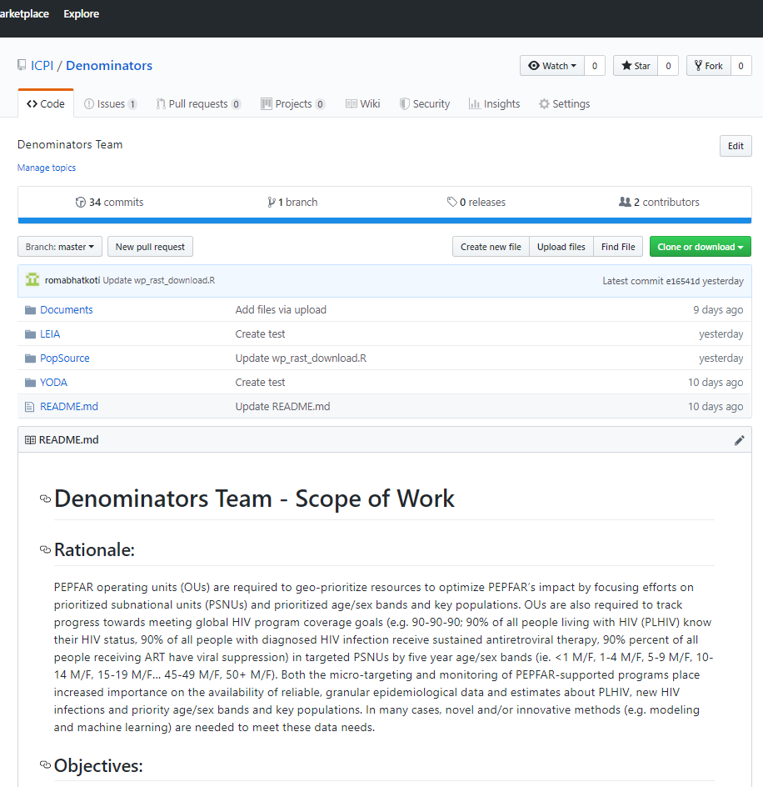
Logistics – Knowledge Management
Denominators Github Repository
https://github.com/ICPI/Denominators

Slide 9
Project 1 - YODA

Slide 10
Ongoing Project 1 - Yield Optimization Data Algorithm (YODA)
Granular Targeted HIV Testing Using Machine Learning
YODA: Goals
If treatment is prevention and testing leads to treatment, then increasing yield rates is of paramount importance in preventing infections.
Many people are being tested, but are we targeting the right people? How would we know?
Can machine learning help target positive individuals for testing by setting testing targets at a granular level?
Can we identify high performing sites and replicate their methods? Can we identify low performing sites and stage interventions?
Yoda: Model
YODA redistributes testing numbers among sites to maximize yield.
Actionable table of recommended # of tests by site/modality/partner/age/sex.
Notes:
YODA: Solution
Construct a machine learning model of yield rate leveraging Spectrum estimates and accounting for things like:
Age
Gender
Population size within age/gender/PSNU
PLHIV within age/gender/PSNU
# on treatment within age/gender/PSNU
# of tests done by the site
Site type
Prioritization
Modality
Partner
Time
Create an optimization algorithm to set targets at the Partner / Modality / Site / Age / Gender disaggregated level.

Slide 11
Project 2: Estimating Male Circumcision Coverage

Slide 12
Ongoing Project 2 – Estimating Male Circumcision Coverage
Goal - To develop a tool to summarizes national and sub-national coverage of medical circumcision (e.g., proportion of men medically circumcised) across 15 priority countries for VMMC.
This tool should be interagency, housed in OGAC, and intrinsically harmonized with related entities like MER VMMC indicators and datapack fields.
Output from the tool should be harmonization with the VMMC achievement data annually released worldwide by WHO, which is the global standard reference.
Current Tool - DMPPT2 tool (developed by Avenir Health) - output doesn’t match PHIA
Proposed Solution - Use Small Area Estimation methodology (currently used for subnational estimation of HIV prevalence and people living with HIV/AIDS) for estimating VMMC at subnational level.

Slide 13
Project 3: LEIA

Slide 14
Ongoing Project 3 – Linkage event identification algorithm (LEIA)
Agent-based spatial method to analyze patient flow among HIV testing and treatment sites
To assess PLHIV movement across sites using testing numbers HTS_TST_POS, treatment numbers, and the simulated spatial location of patients in relation to the treatment facilities within their spatial neighborhood.
To identify where newly identified HIV positive persons are linked to treatment.
To identify sites (facilities or commune) with the largest linkage gaps (i.e., newly identified HIV positive persons who are not linked to care)
To identify potential bottlenecks to treatment by analyzing patient flow from sites (facilities or commune) with the largest treatment gaps to neighboring sites.

Slide 15
Project 4 – Population Source Model

Slide 16
Ongoing Project 4 – Population Source Model
PLHIV estimation requires subnational population numbers
Primary source subnational population – actual census counts published by the various countries
Issues with using census counts for PLHIV estimation
frequency
data gaps
reliability
Solution – provide population alternatives to census counts for countries.

Slide 17
Ongoing Project 4 – Population Source Model (cont’d)
Potential Population Sources
WorldPop - https://www.worldpop.org/
LandScan - https://landscan.ornl.gov/
Facebook - https://data.humdata.org/organization/facebook
Gridded Population of the World (GPW) - https://sedac.ciesin.columbia.edu/data/collection/gpw-v4
GHS POP - https://ghsl.jrc.ec.europa.eu/ghs_pop2019.php
Global Rural-Urban Mapping Project (GRUMP) - https://sedac.ciesin.columbia.edu/data/collection/grump-v1
ArcGIS Living Atlas of the World - https://livingatlas.arcgis.com/en/browse/#d=2&q=World%20Population%20Estimate
US Census Subnational Population by Sex, Age, and Geographic Area - https://www.census.gov/geographies/mapping-files/time-series/demo/international-programs/subnationalpopulation.html

Slide 18
Ongoing Project 4 – Population Source Model (cont’d)
Collaboration with UNAIDS Reference Group on Estimates, Modelling and Projections
Review sources to recommend best ‘default’ source for population inputs by SNU2 / age / sex.
Be able to provide countries with documentation for basic methodologies and specific data sources that were used for population inputs (e.g. which censuses, at what level of stratification.)
Record any country-specific challenges or discrepancies that should be considered by country teams when creating their estimates.
Notes:
Population Source Model
Method - Using Rasterized Population Data
Connect to the publically available population database such as WorldPop, a High spatial resolution, contemporary data on human population.
Use publically available R packages to gather iso3 names (identifiers for countries) for PEPFAR countries from WorldPop FTP.
Developed R script to download individual (PEPFAR) countries population raster datasets for the most recent years from WorldPop FTP.
Download PEPFAR subnational shape files from ArcGIS online.
Developed R script to run zonal statistics for PEPFAR subnational units (which means calculating subnational population for PEPFAR countries).
This method is generalizable for all population data available in rasterized form.
Import the subnational populations into PAW.

Slide 19
Thanks!
Questions

